Slide 1
Hotel Property Management System
Presented By:-
Jatinder Bali
Khushbu Thakur
Monish M M
Puja Ghimire

Slide 2
Summary:
Hotel Property Management System is a platform where the guest’s bookings are displayed to the hotel and the admin team can assist the guest(s) when they come for a stay.
This management system ensures sound communication between the housekeeping staff and the administrator so that the waiting time of guest is eliminated.
For the betterment of guest’s staying experience, Preference Notes are maintained for all the special requests made by the guest.
This system also handles overbooking by using the sister properties present in the same ZIP codes to allocate rooms.

Slide 3
OBJECTIVES
A centralized database should be maintained for all the property branches, which can be accessed from any location.
Real-time updates between housekeeping and front desk can be maintained in order to avoid miscommunication
Necessity of creating a customer account and maintaining their history which can be accessed at anytime from anywhere.
Front-desk team must be able to view and book rooms for customers as well as present dynamic rates.

Slide 4
PROBLEM STATEMENTS
Miscommunications can be caused between the housekeeping and front desk team regarding the room status which increases the customer wait time.
To check customer preferences for maintaining customer satisfaction requires previous reservation records from all hotel branches which can be difficult to maintain in a local file as the retrieval process of the data takes time.
Overbooking causes difficulty in managing room allocation
Maintaining dynamic pricing of the rates based on events, seasons and availability of rooms can make walk-in reservations difficult.

Slide 5
OUR SOLUTIONS
Using current TIMESTAMP in database system for Real Time updates. Data added to the ROOM STATUS table can be used to check the room’s status whose right of accessibility is given to both Housekeeping and Front-desk department.
Dynamic rates can be tackled using STNDRD_RATE attribute present in a ROOM_TYPE ENTITY in combination with RACK_AMOUNT attribute present in RACK_RATE ENTITY.
A PREFERENCES table is maintained that can be accessed anywhere from any hotel property which contains notes about the guest’s likes and dislikes.
A special discount is given to staff and members of the hotel which is maintained in the DISCOUNT table.
A table HOTEL contains all details of hotel properties along with its ZIP CODE and ROOM_AVAILABILITY which can be used to check the properties that bear the same ZIP CODE and has rooms available in it can be checked and the guests can be allocate a room in a sister property when there is overbooking
The Guest is also charged on the type of Amenities requested while booking the room. A separate AMENITY table is maintained which contains AMENITY_PRICE that defines the price of amenities offered by the hotel.

Slide 6
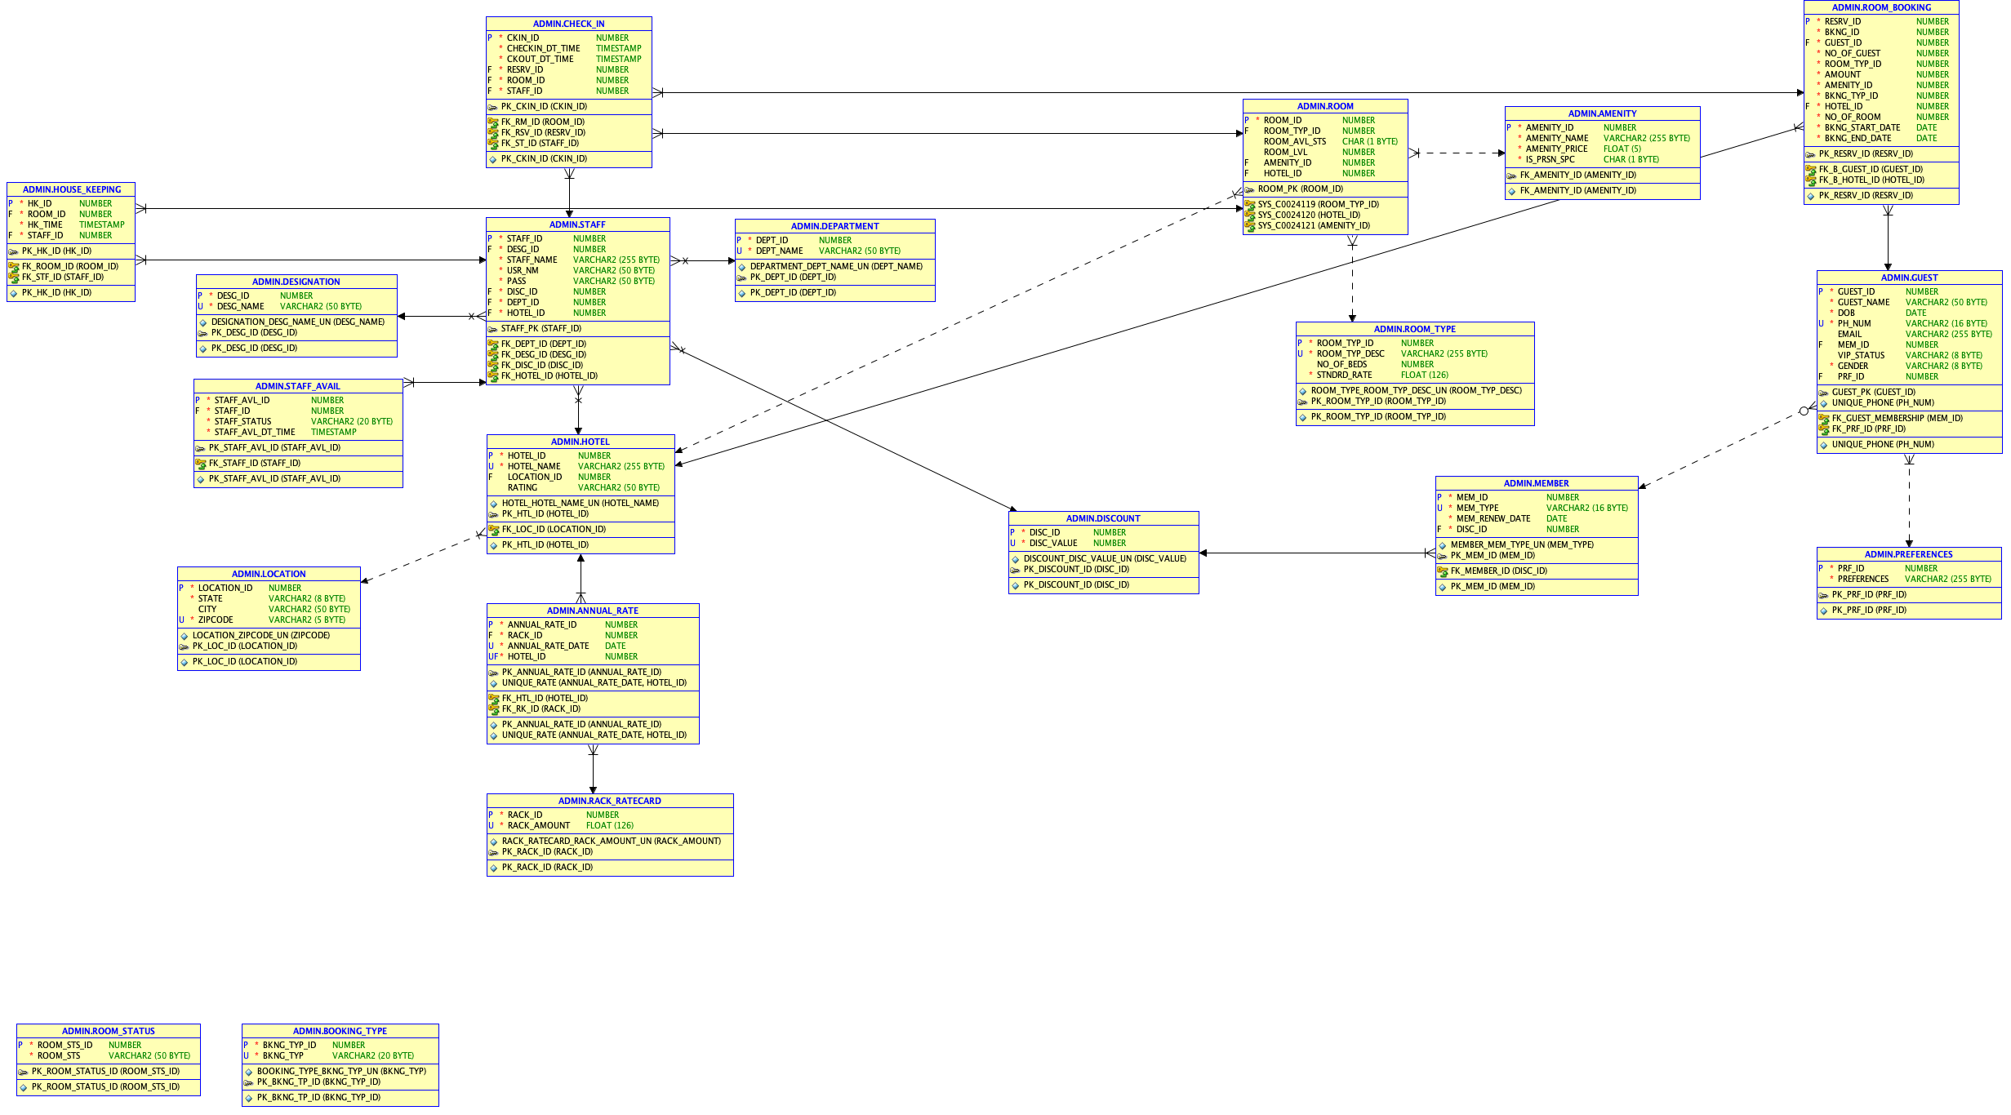
ER- DIAGRAM

Slide 7
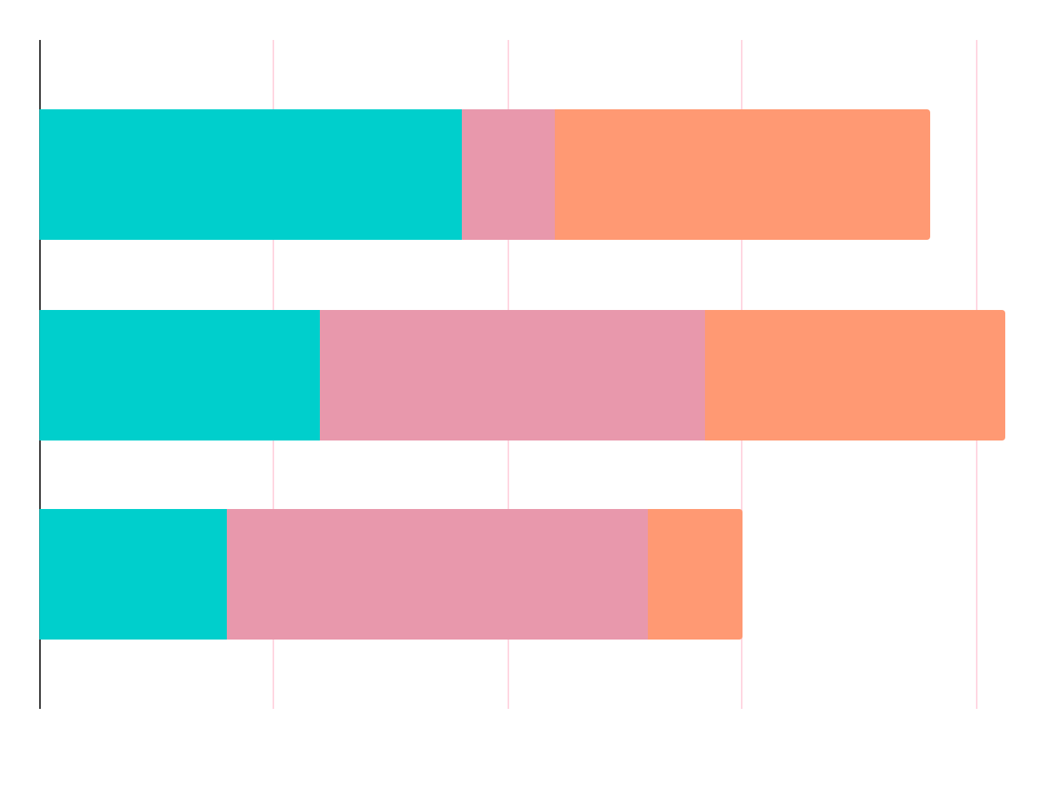
MEMBER CONTRIBUTION
Khushbu Thakur
Puja Ghimire
Monish M M
Jatinder Bali
Table Creation Stored Procedures INDEX Constraints Functions Packages
Domain Research Table Creation INDEX Constraints Data Insertion Reports
Table Creation Stored Procedures INDEX Constraints functions Packages Triggers
Table Creation INDEX Constraints Data Insertion Reports User Grants

Slide 8
THANKS!
questions?

